Slide 1

Unit 6 Chapter 6
SUPPLY, DEMAND AND GOVERNMENT POLICIES

Slide 2
PRICE CONTROLS
Ice cream is sold in a competitive market free of government regulation
Stakeholders can lobby the government to alter the existing prices in their favour
Price ceiling and price floors
Example of rental prices and minimum wages
If government imposes a legal maximum on the price at which ice-cream cones can be sold, because the price is not allowed to rise above this level, the legislated maximum is called a price ceiling
If the government imposes a legal minimum on the price. Because the price cannot fall below this level, the legislated minimum is called a price floor

Slide 3
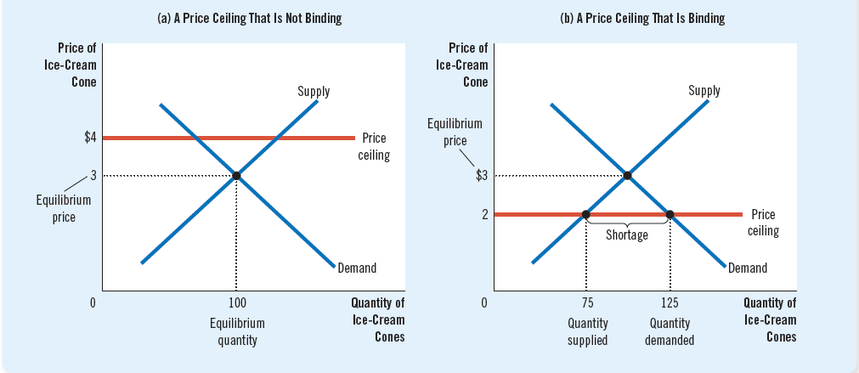
PRICE CONTROLS: PRICE CEILING
Two possible outcomes of a price ceiling
Non-binding price ceiling (above market-clearing price) Does not have any effect
Binding price ceiling (below the market-clearing price) Creates a shortage because of low price excess demand

Slide 4
PRICE CONTROLS: PRICE CEILING
Rationing mechanism developed in the market or based on sellers’ bias
Buyers who get ice cream at a lower price have to wait in long lines for their turn while some buyers do not get the good at all
Even though the price ceiling was motivated by a desire to help buyers of ice cream, not all buyers benefit from the policy
When the government imposes a binding price ceiling on a competitive market, a shortage of the goods arises, and sellers must ration the scarce goods among a large number of potential buyers
Undesirable and inefficient rationing mechanism
Sellers’ bias reduces the chance of the person getting the good who values it the most

Slide 5
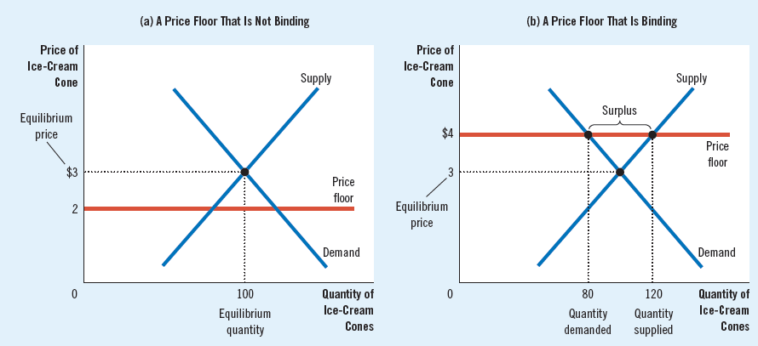
PRICE CONTROLS: PRICE FLOOR
Two possible outcomes of a price floor
Non-binding price floor (below the market-clearing price) Does not have any effect
Binding price floor (above the market-clearing price) Creates a surplus because of high price excess supply

Slide 6
PRICE CONTROLS: PRICE FLOOR
Some sellers who want to sell ice cream are unable to because of a lack of demand
The sellers who sell ice cream do not necessarily do it fairly and show the bias of getting orders from known ones
Price controls are deemed as inefficient policies as they distort the optimal allocation of society’s resources
Price controls are intended for the betterment of the society but eventually result in undesirable outcomes
Any alternative policies such as providing subsidies, need simultaneous taxation policies also

Slide 7
TAXES
Taxes are means of raising government revenues for public projects in the economy
Suppose, like, in IIT Hostels, the local authorities also conduct an ice cream fest for the entire economy
To raise revenue from the fest, the government imposes a tax of $0.5 per scoop sold
Groups of sellers and buyers arrive and they argue that the other groups should bear the burden of taxation
Who bears the burden of taxes is answered by the concept of tax incidence: the local government says each group pays half the tax
Tax incidence: the manner in which the burden of a tax is shared among participants in a market
Tax put on sellers and buyers separately
Tax reduces the willingness to sell/buy (height of the curve) by the size of the tax

Slide 8
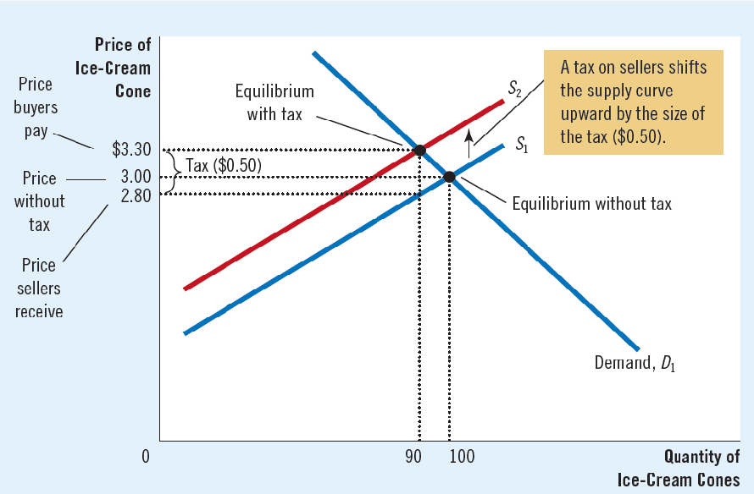
TAXES: EFFECT ON MARKETS
When sellers face a tax of $0.50 per scoop of ice cream
Step 1: tax on sellers shifts the supply curve (D does not change)
Step 2: tax reduces supply and therefore the curve shifts leftwards
Step 3: the price of ice cream rises from $3.00 to $3.30, and the equilibrium quantity falls from 100 to 90 cones
Because sellers sell less and buyers buy less in the new equilibrium, the tax reduces the size of the ice-cream market

Slide 9
TAXES: EFFECT ON MARKETS
3.5

Slide 10
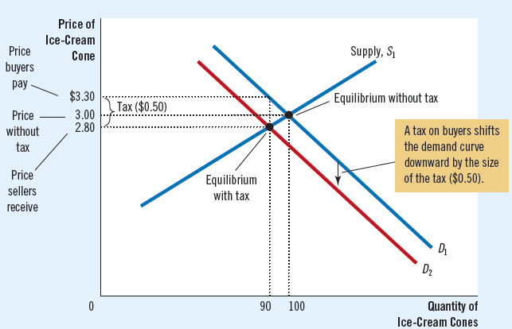
TAXES: EFFECT ON MARKETS
When buyers face a tax of $0.50 per scoop of ice cream
Step 1: tax on buyers shifts the demand curve (S does not change)
Step 2: tax reduces demand and therefore the curve shifts leftwards
Step 3: the equilibrium price of ice cream falls from $3.00 to $2.80, and the equilibrium quantity falls from 100 to 90 cones
Because sellers sell less and buyers buy less in the new equilibrium, the tax reduces the size of the ice-cream market

Slide 11
TAXES: EFFECT ON MARKETS
2.5

Slide 12
TAXES: EFFECT ON MARKETS
A tax imposed by the government shifts the equilibrium to a new one where the quantity exchanged in the economy is less than the original one
Tax places a wedge between the price that buyers pay and the price that sellers receive
The wedge between the buyers’ price and the sellers’ price is the same whether the tax is levied on buyers or sellers
Both buyers and sellers share the burden of taxation
Buyers will pay a higher price while sellers will receive an effectively lower price

